Slide 1
TABLEAU
Tableau Visual Formatting And Analysis

Slide 2
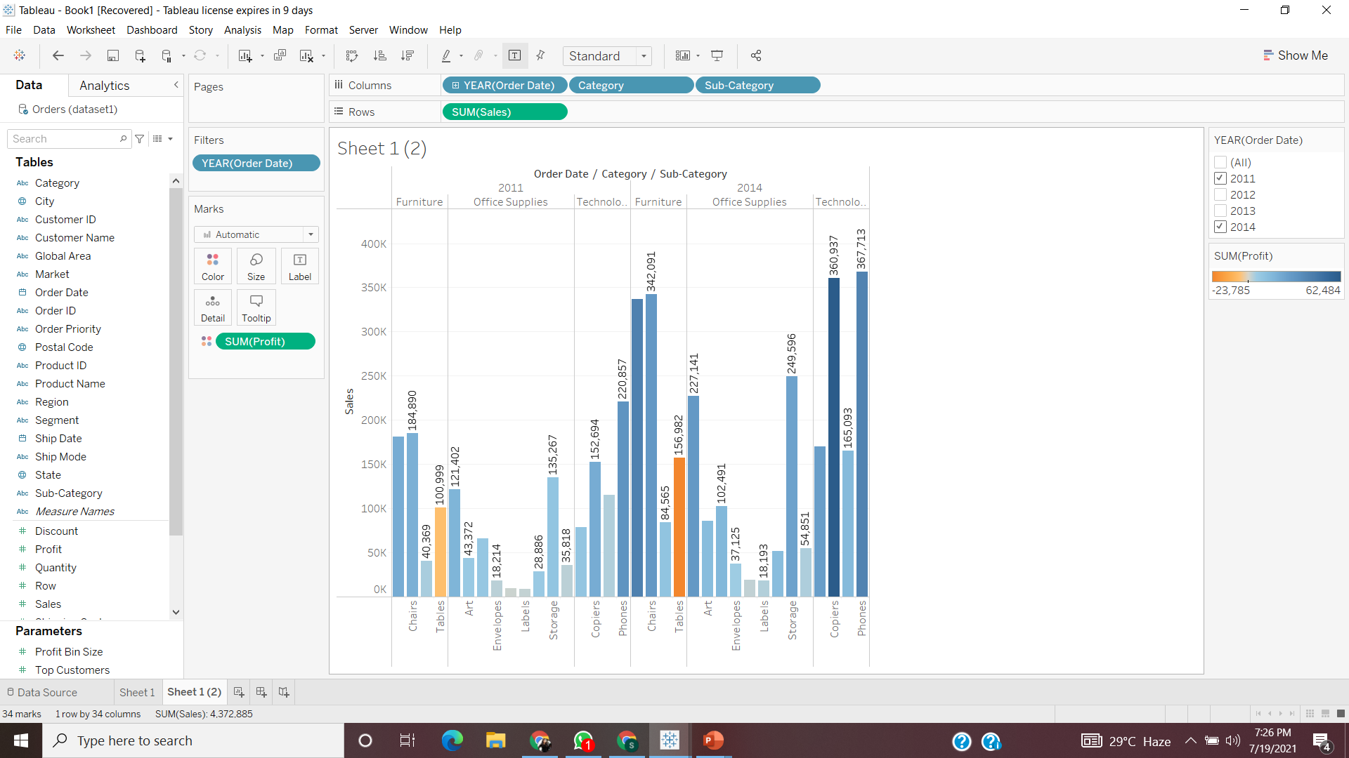
Check your view for the year 2011 and 2014

Slide 3
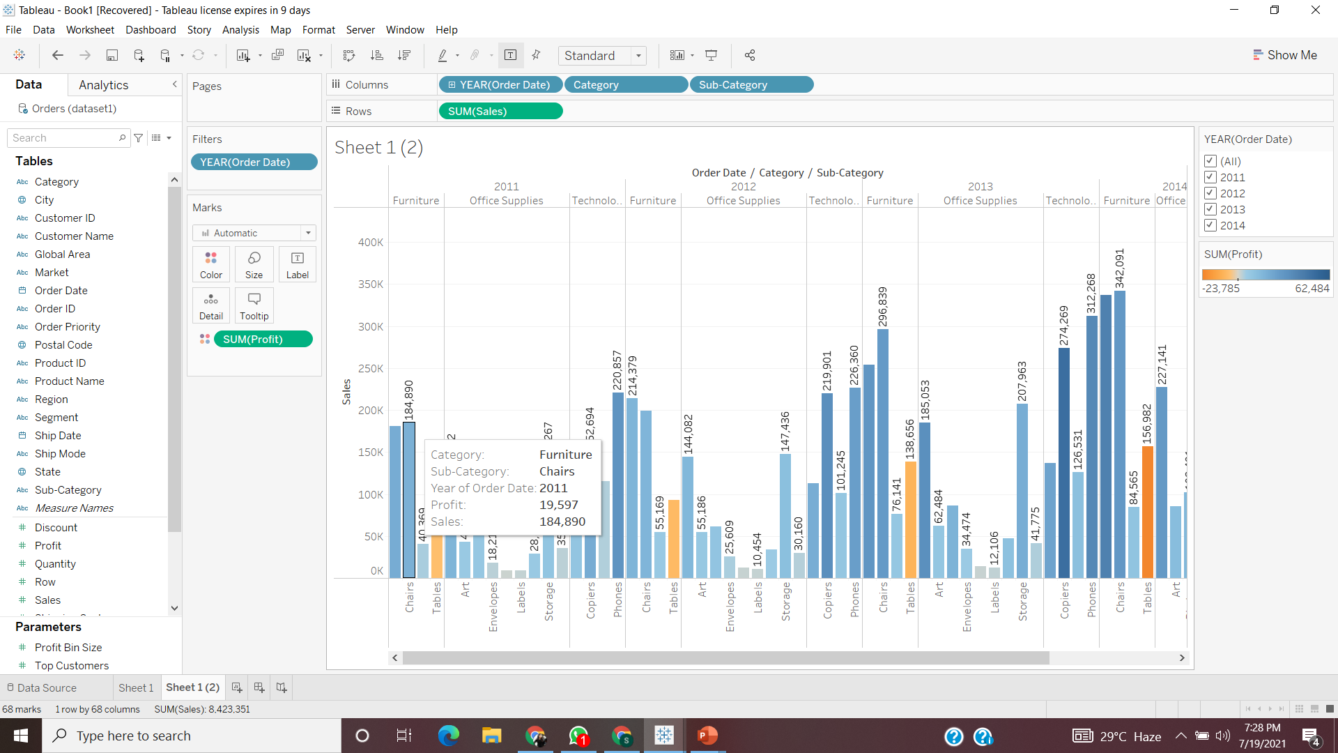
Show the profit in the tooltip for sales for each subcategory of every type of product.

Slide 4
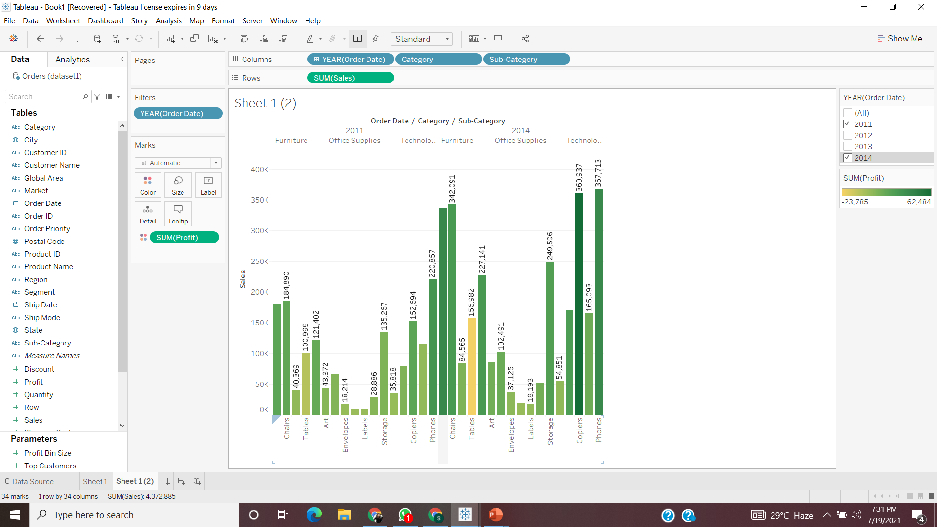
In scenario 1, change the color of the view from the Marks card

Slide 5
Identify the subcategory & category that are having negative profit
2011: In Category Furniture, Tables have negative profit = -6301
2012: In Category Furniture, Tables have negative profit = -7968
2013: In Category Furniture, Tables have negative profit = -10,015
2014: In Category Furniture, Tables have negative profit = -23,785

Slide 6
Identify the subcategory & category that have highest profit.
2011: In Category Technology, phones have highest profit =32,816
2012: In Category Technology, phones have highest profit = 27,232
2013: In Category Technology, phones have highest profit =38,225
2014: In Category Technology, phones have highest profit =40,968

Slide 7
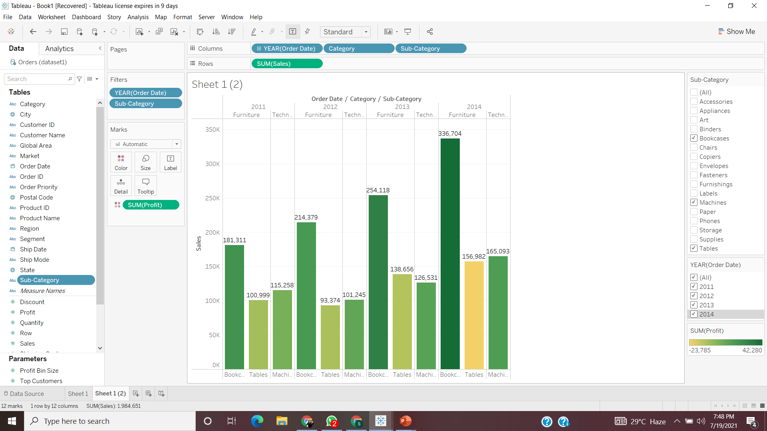
In the view, in the Sub-Category filter card, clear all of the check boxes except Bookcases, Machines, and Tables and have closer look on each value.

Slide 8
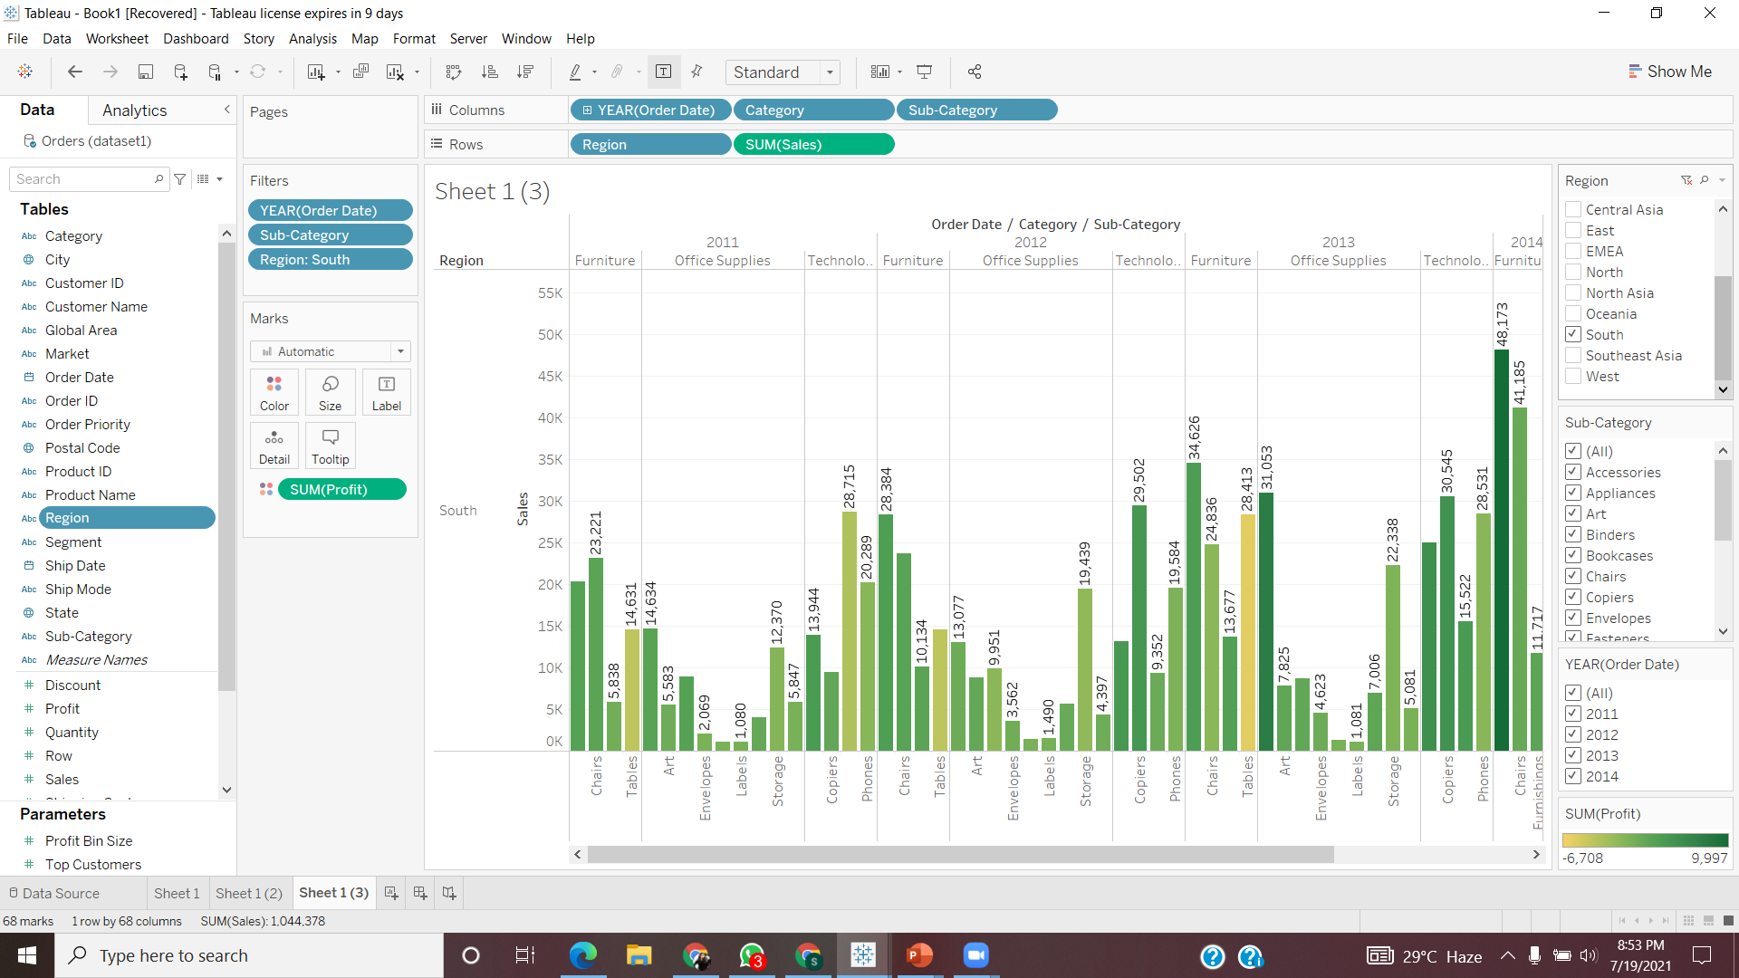
Show the sales region wise for every subcategory and category and every year.

